Slide 1
Why A Pretribulationary Rapture? (Part 2)
November 14, 2021

Slide 2
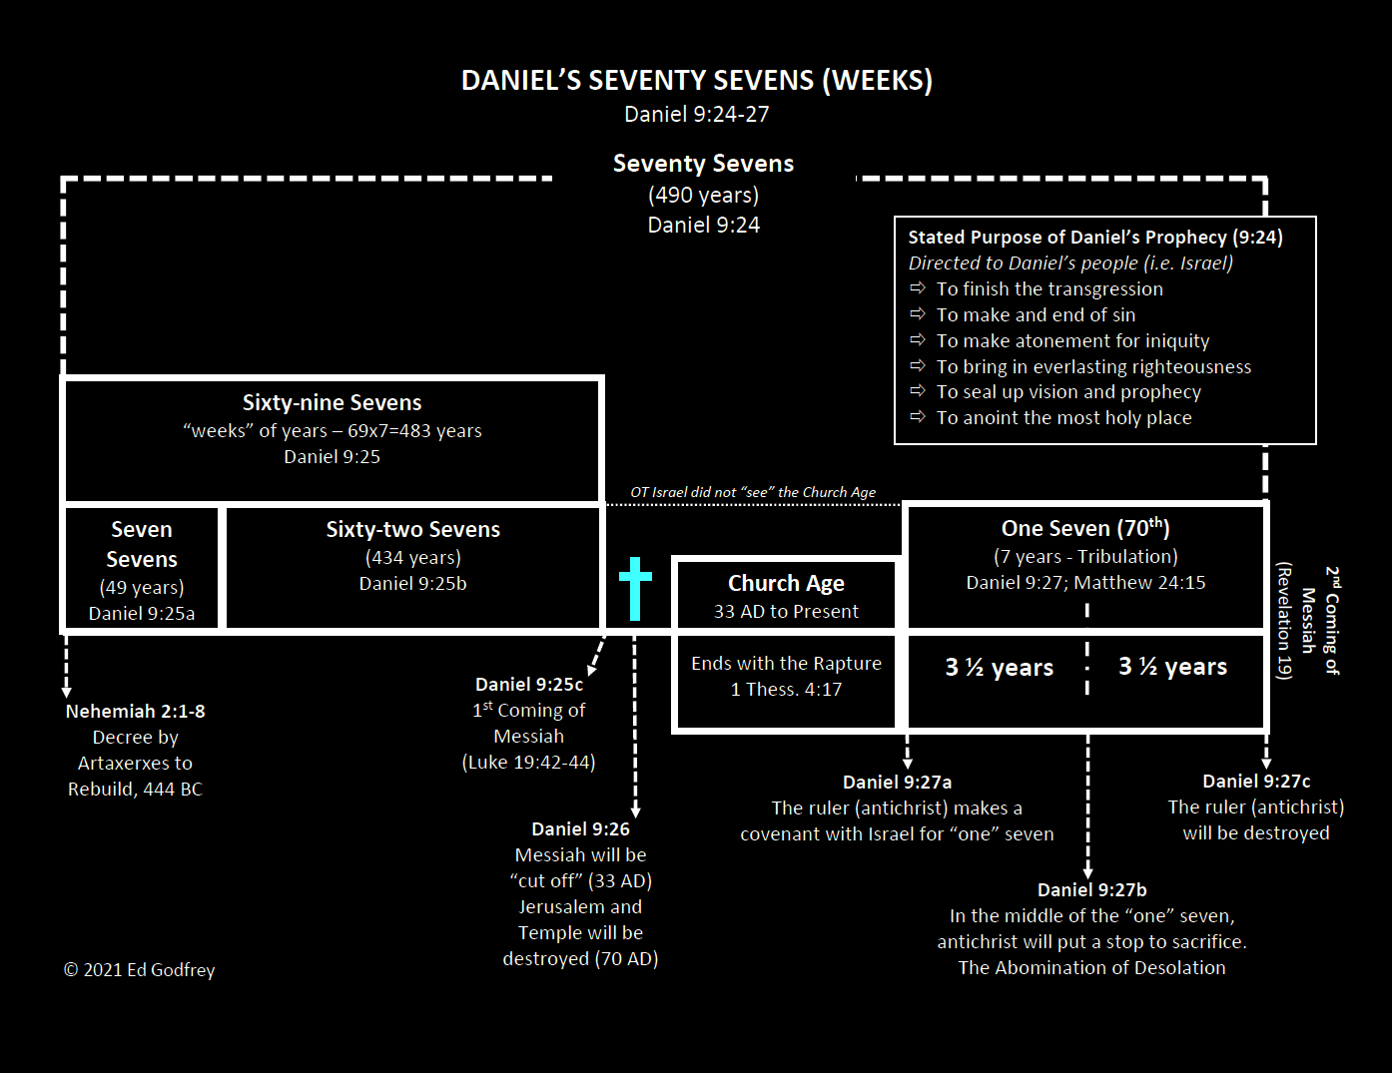

Slide 3
Daniel’s 69 weeks
483 years

Slide 4
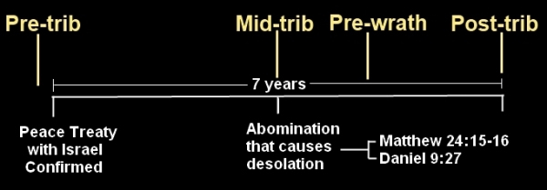

Slide 5
Will the rapture be “pre”, “mid”, or post in relationship to Daniel’s Seventieth Week (the seven-year tribulation)?
The Church is not mentioned in Revelation 6-19 as being on earth.
The rapture is rendered inconsequential if it is posttribulational.
The epistles contain no preparatory warnings of an impending tribulation for church age believers.
1 Thessalonians 4:13-18 demands a pretribulational rapture.
John 14:1-3 parallels I Thessalonians 4:13-18.

Slide 6
Comparison of John 14:1-3 to 1 Thessalonians 4:16-17
John 14:1-3
14 Do not let your heart be troubled; believe in God, believe also in Me. 2 In My Father's house are many dwelling places; if it were not so, I would have told you; for I go to prepare a place for you. 3 If I go and prepare a place for you, I will come again and receive you to Myself, that where I am, there you may be also.
1 Thessalonians 4:16-17
For the Lord Himself will descend from heaven with a shout, with the voice of the archangel and with the trumpet of God, and the dead in Christ shall rise first. Then we who are alive and remain shall be caught up together with them in the clouds to meet the Lord in the air, and so we shall always be with the Lord. Therefore, comfort one another with these words.
Notes:
It is interesting that Jesus says “I will come again and RECEIVE you to Myself…” receive = paralambano – to come along side and take to one’s self. It is in the first person, singular, future, middle voice. This means that at some point in the future, Jesus intends to come alongside His redeemed and personally take them to Himself. The middle voice speaks of doing something to one’s self for one’s self without reference to any action being taken (or not taken) by the objects being received. Some interpret 1 Thessalonians as some kind of reception for a king where the people go outside the city to meet the king and then accompany him back into the city. The idea is that there is no rapture into heaven, but that we meet the Lord in the air to immediately come back with Him to usher in the millennial kingdom (post trib view) or to usher in the eternal state (post and amil views). To be caught up is a passive event, something the Lord does; and there is no mention of being back on the earth in any immediate sense.

Slide 7
Will the rapture be “pre”, “mid”, or post in relationship to Daniel’s Seventieth Week (the seven year tribulation)?
The Church is not mentioned in Revelation 6-19 as being on earth.
The rapture is rendered inconsequential if it is posttribulational.
The epistles contain no preparatory warnings of an impending tribulation for church age believers.
1 Thessalonians 4:13-18 demands a pretribulational rapture.
John 14:1-3 parallels I Thessalonians 4:13-18.
The nature of events at Christ’s posttribulational coming radically differs from that of the rapture.

Slide 8
Differences between the Rapture and the 2nd Coming of Christ
At the rapture, believers depart the earth (1 Thessalonians 4:15-17), while at the final event of the second coming unbelievers are taken away from the earth (Matthew 24:37-41).
At the rapture, unbelievers remain on earth (implied), while at the final event of the second coming believers remain on earth (Matthew 25:34).
At the rapture, there is no mention of establishing Christ’s kingdom on earth, while at the final event of the second coming Christ has come to set up His kingdom on earth (Matthew 25:31, 34).
At the rapture, believers will receive glorified bodies (1 Corinthians 15:51-57), while at the final event of the second coming no one will receive glorified bodies.

Slide 9
Will the rapture be “pre”, “mid”, or post in relationship to Daniel’s Seventieth Week (the seven year tribulation)?
The Church is not mentioned in Revelation 6-19 as being on earth.
The rapture is rendered inconsequential if it is posttribulational.
The epistles contain no preparatory warnings of an impending tribulation for church age believers.
1 Thessalonians 4:13-18 demands a pretribulational rapture.
John 14:1-3 parallels I Thessalonians 4:13-18.
The nature of events at Christ’s posttribulational coming radically differs from that of the rapture.
Revelation 3:10 promises that the church will be removed prior to Daniel’s 70th week.

Slide 10
Revelation 3:7-13
7 And to the angel of the church in Philadelphia write: He who is holy, who is true, who has the key of David, who opens and no one will shut, and who shuts and no one opens, says this: 8 'I know your deeds. Behold, I have put before you an open door which no one can shut, because you have a little power, and have kept My word, and have not denied My name. 9 'Behold, I will cause those of the synagogue of Satan, who say that they are Jews and are not, but lie — I will make them come and bow down at your feet, and make them know that I have loved you. 10 'Because you have kept the word of My perseverance, I also will keep you from the hour of testing, that hour which is about to come upon the whole world, to test those who dwell on the earth. 11 'I am coming quickly; hold fast what you have, so that no one will take your crown. 12 'He who overcomes, I will make him a pillar in the temple of My God, and he will not go out from it anymore; and I will write on him the name of My God, and the name of the city of My God, the new Jerusalem, which comes down out of heaven from My God, and My new name. 13 'He who has an ear, let him hear what the Spirit says to the churches.'

Slide 11
Why Futuristic Premillennialism?
October 17, 2021

